Slide 1

Snort Based Intrusion Detection ft. ML Models
Archi Gupta (21111014)
Hirak Mondal (20111022)
Manjyot Singh Nanra (21111038)
Neeraj Chouhan (21111044)
Sharanya Saha (21111056)
Team: CICADA3301
Guide: Prof. Sandeep Shukla
Notes:
mj

Slide 2
Problem Statement
Implementing different ML classification algorithms for intrusion detection using SNORT
Demonstrate and evaluate the live working of our modified NIDS by performing attacks from Kali Linux Machine to Ubuntu Machine
To integrate ML model with SNORT for Intrusion Detection
Notes:
mj

Slide 3
Introduction
Snort IDS can search and match rules with network traffic data in order to detect attacks and generate alert.
Large value of false-positive rate makes the rule-based NIDS system unreliable.
Hence, planned to deploy ML algorithms that can help in improving the current rule-based NIDS.
Notes:
mj

Slide 4
Introduction (cont.)
Trained ML models on publicly available dataset for Network intrusion detection
Performed real time DoS (syn flood) attacks from Kali Linux Machine to Ubuntu Machine
Used Snort to capture the packets, preprocessed it to get connection information and applied ML models on it to detect the attacks
Notes:
Mj

Slide 5

Tools Used: SNORT
Open Source Intrusion Detection System (IPS)
Uses a series of rules that help define malicious network activity and uses those rules to find packets that match against them and generates alerts for users
Can be deployed inline to stop these packets, as well
Notes:
NC

Slide 6
Tools Used: SNORT (cont.)
Snort has three primary uses:
As a packet sniffer like tcpdump
as a packet logger — which is useful for network traffic debugging
can be used as a full-blown network intrusion detection system
We have used SNORT as a packet sniffer and as a packet logger in our project
Notes:
NC

Slide 7

ATTACKS PERFORMED
SYN Flooding with Metasploit Framework(MSF):
TCP SYN flood is a type of Denial of Service (DoS) attack that exploits part of the normal TCP three-way handshake to consume resources on the targeted server and render it unresponsive.
Notes:
HM

Slide 8
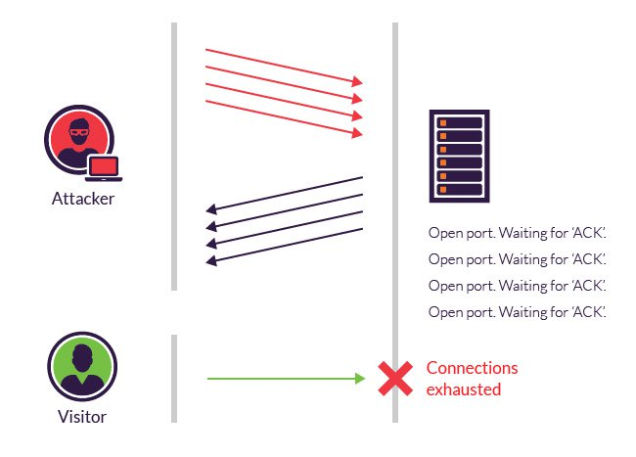
ATTACKS PERFORMED (cont.)
Notes:
HM

Slide 9
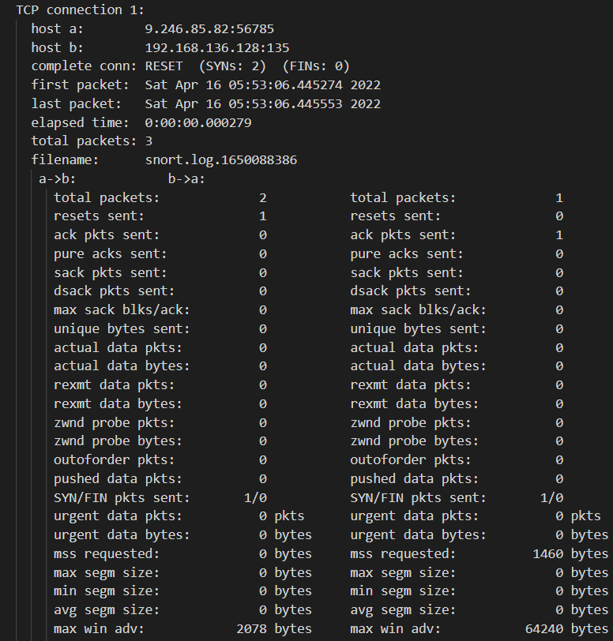
TCPTRACE OUTPUT
Notes:
mj

Slide 10
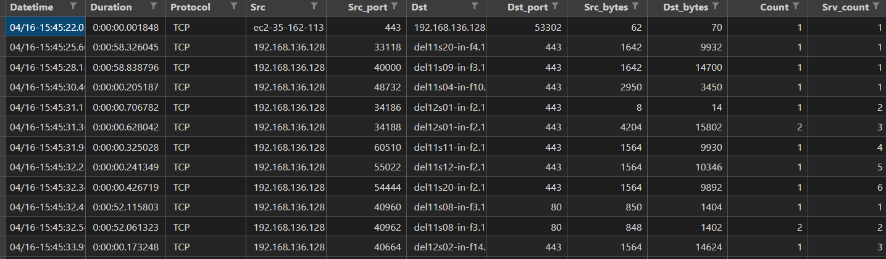
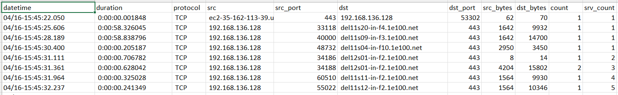
Processed tcptrace logs
Notes:
mj

Slide 11
Applying Machine Learning
Problem Statement: Classifying connections into ‘normal’ and ‘attack’
Dataset used: NSL-KDD
Notes:
MJ

Slide 12
Training Dataset: NSL-KDD
Data set contains 43 features per record,
41 of the features referring to the traffic input itself
last two are labels (whether it is a normal or attack) and Score (the severity of the traffic
Why NSL-KDD?
After preprocessing logs from SNORT traffic, we get 6 overlapping features between the SNORT Traffic and NSL-KDD Dataset
Features are: (Duration, Protocol, Src_bytes, Dst_bytes, Count, Srv_Count)
Count and Srv_count are time based features derived from the Snort Traffic.
Notes:
MJ

Slide 13
Data Pre-processing
Derivation of additional features- count, srv_count
For Binary classification we have used output class labels as ‘Normal’ and replaced all others with ‘Attack’
The categorical labels are handled using label encoder
NSL-KDD dataset has been divided into a training set and a test set.

Slide 14
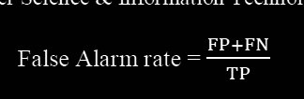

Evaluation Metrics
False Alarm Rate:
False Alarm rate is calculated as the number of all incorrect predictions divided by the number of true positives. It is given by the relation :
Accuracy:
The accuracy (AC) is the proportion of the total number of predictions that were correct. It is given by the relation:

Slide 15
Algorithms
Decision Tree Classifier
Logistic Regression
Random Forest Classifier
K-Nearest Neighbor(KNN) Classifier
Stochastic Gradient Descent(SGD) Classifier
AdaBoost Classifier
Gradient Boosting Classifier
Histogram-Based Gradient Boosting Classifier
Multi Layer Perceptron (MLP) Classifier
Gaussian Naive Bias
Multinomial Naive Bias
Notes:
Sharanya:
We have implemented a few supervised ML algorithms, the list of the algorithms used are on the screen

Slide 16
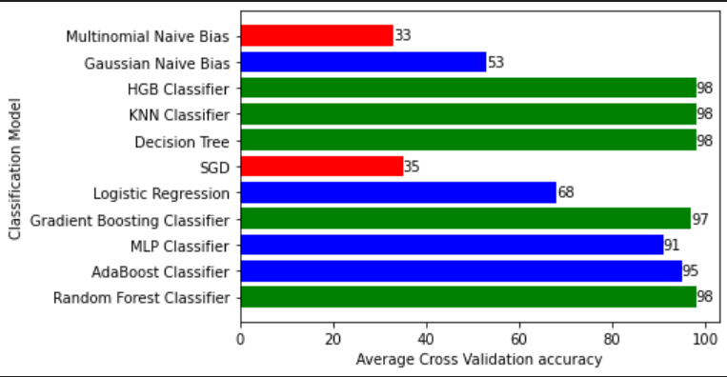
Results
Average Cross validation accuracy (7 fold) :
Notes:
Sharanya:
We have used cross validation to determine the best model for classification:
Decision tree is a tree-structured classifier, where internal nodes represent the features of a dataset, branches represent the decision rules and each leaf node represents the outcome
Random forest, like its name implies, consists of a large number of individual decision trees that operate as an ensemble. Each individual tree in the random forest spits out a class prediction and the class with the most votes becomes our model’s prediction.
Gradient boosting classifiers are a group of machine learning algorithms that combine many weak learning models together to create a strong predictive model. Decision trees are mostly used when doing gradient boosting.
Histogram based gradient boosting estimator is much faster than GradientBoostingClassifier for big datasets (n_samples >= 10 000)

Slide 17
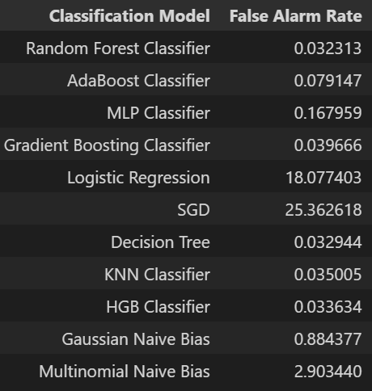
Results
False Alarm Rate:
Notes:
Sharanya

Slide 18
Predictions :
Type of attack | Total Number of connections | Number of connections classified as attack
DoS | 5746 | 5714
Non-Attack | 11 | 0
Notes:
Sharanya:
After finding the best ML model, we used the same for making predictions on our simulated attacks. As we can see, that we performed Dos, and the total number of connections formed were 5746. 5714 out of the total were classified as attack, i.e. 99.4%
We also simultaed a few non-attack connection and all of them were classified as normal connections.

Slide 19
Future Work
Merge Snort Intrusion detection and our Machine Learning model to make snort robust

